Slide 1
Trend in Government Health Expenditure Per Capita

Slide 2
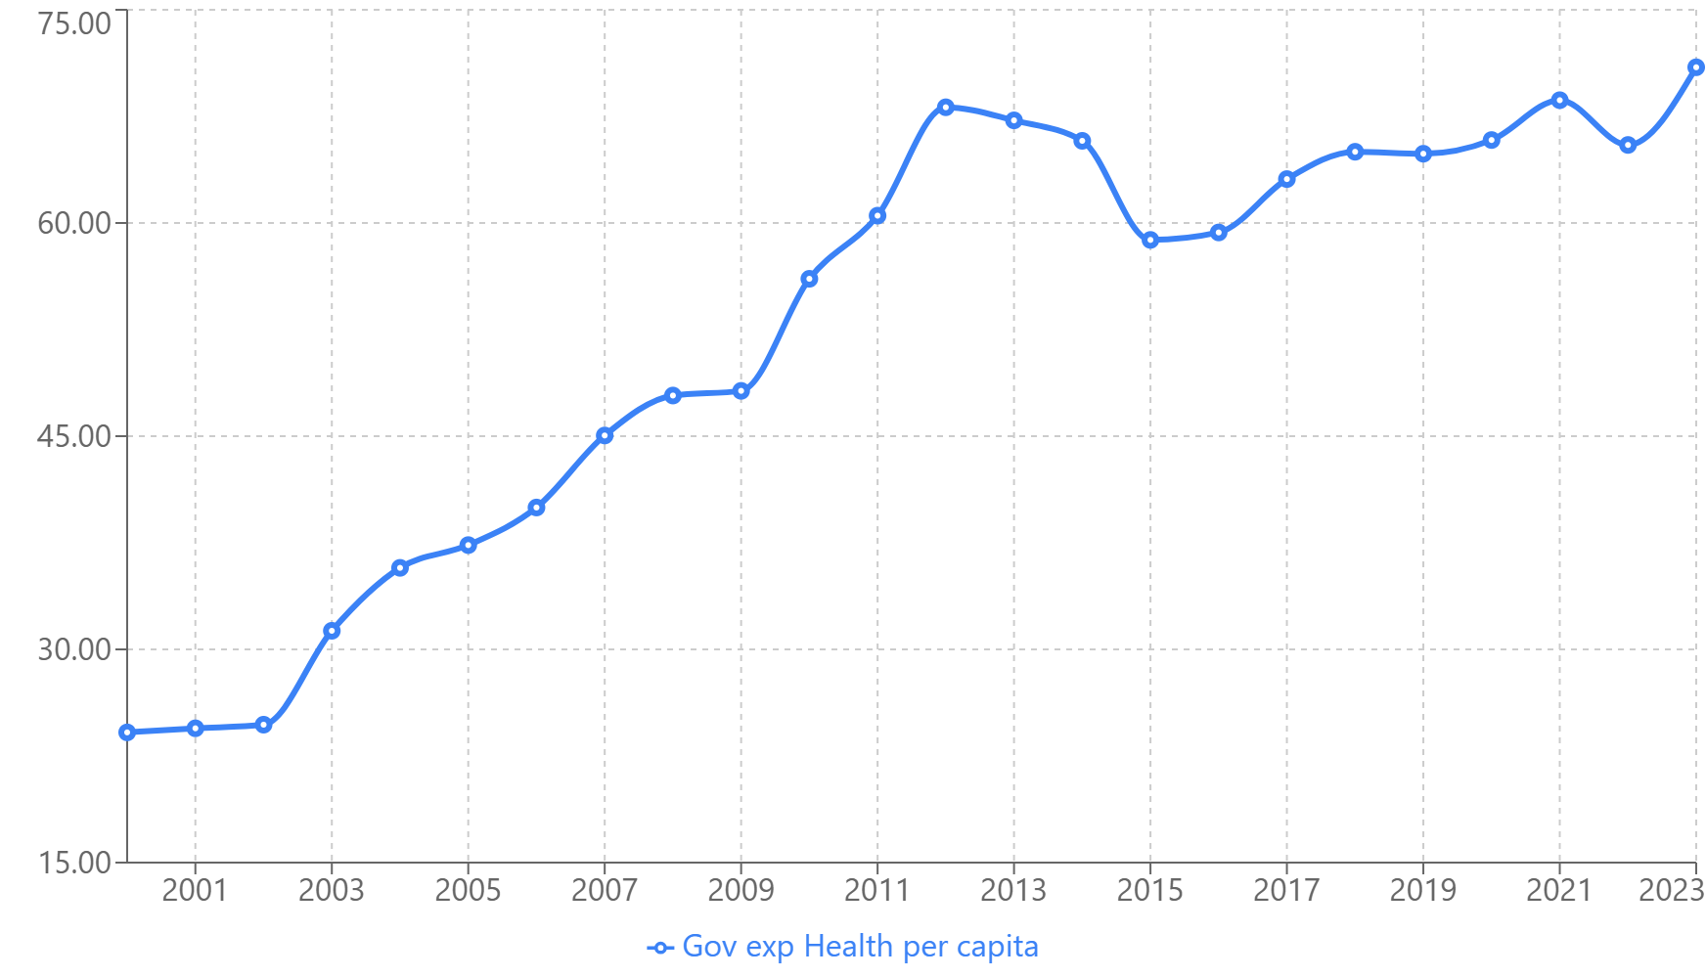
Trend in Government Health Expenditure Per Capita (Africa wide)

Slide 3
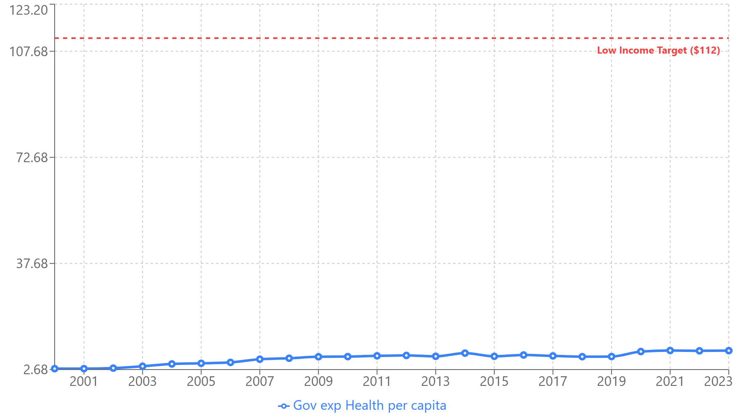
Trend in Government Health Expenditure Per Capita (Low-income countries)

Slide 4
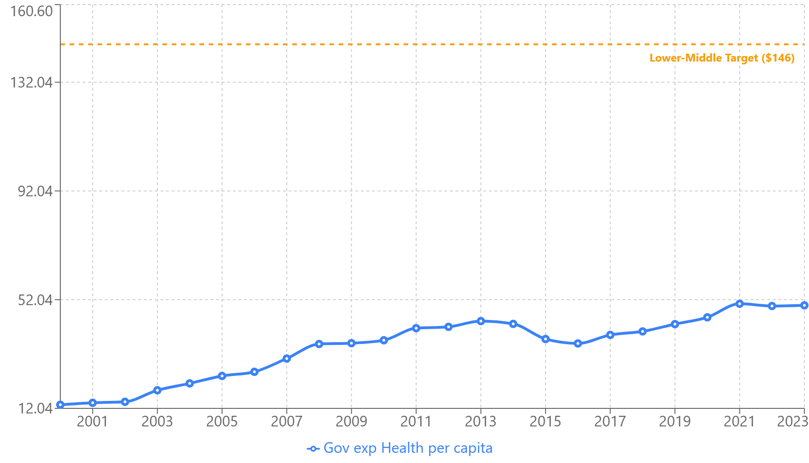
Trend in Government Health Expenditure Per Capita (Lower-middle income countries)

Slide 5
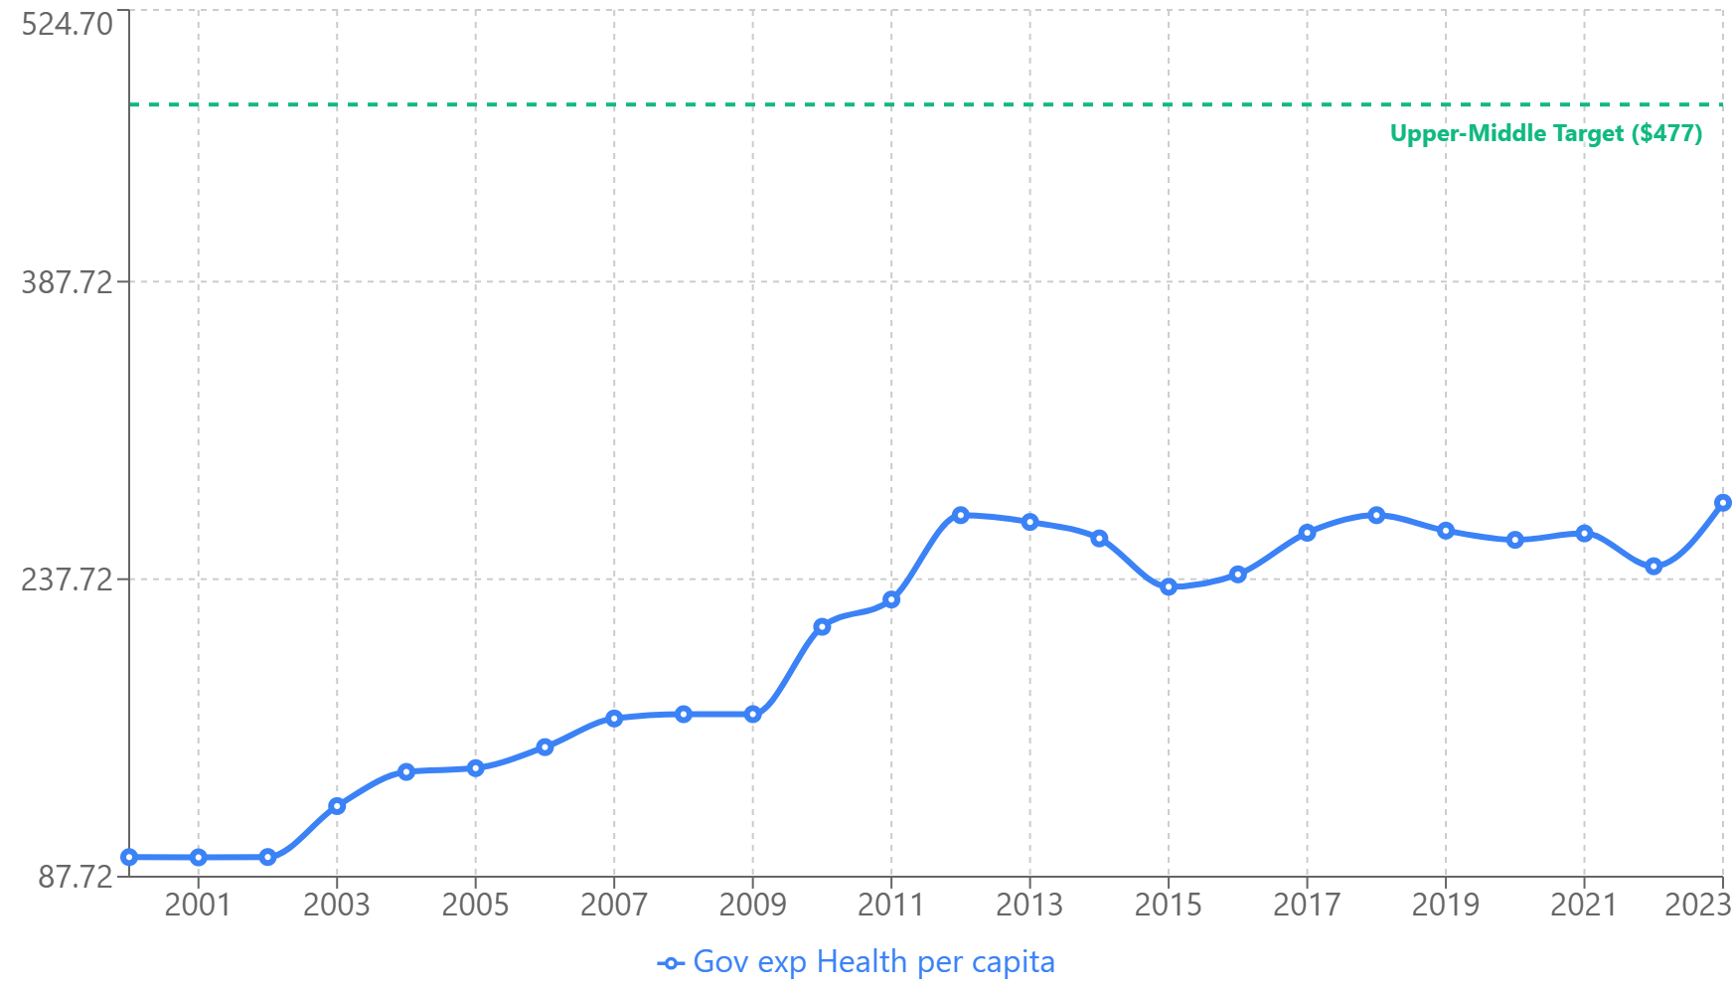
Trend in Government Health Expenditure Per Capita (Upper-middle income countries)

